Slide 1
1960s through 1980s

Slide 2
1960s
Members' wives welcome arrivals to the 1960 Kiwanis International convention in Miami Beach, Florida, USA.

Slide 3
1960s
A Kiwanian shares his opinion during the house of delegates session at the 1961 convention in Toronto, Ontario, Canada. Delegates voted to open clubs outside the United States and Canada.

Slide 4
1960s
A long-standing holiday tradition, Pittsburgh, Pennsylvania, USA, Kiwanians ring bells for the Salvation Army annual kettle collection.

Slide 5
1960s
February 25, 1963. The first Kiwanis Club in Europe is organized, in Vienna, Austria. In 1968 Kiwanis International Europe is formed.

Slide 6
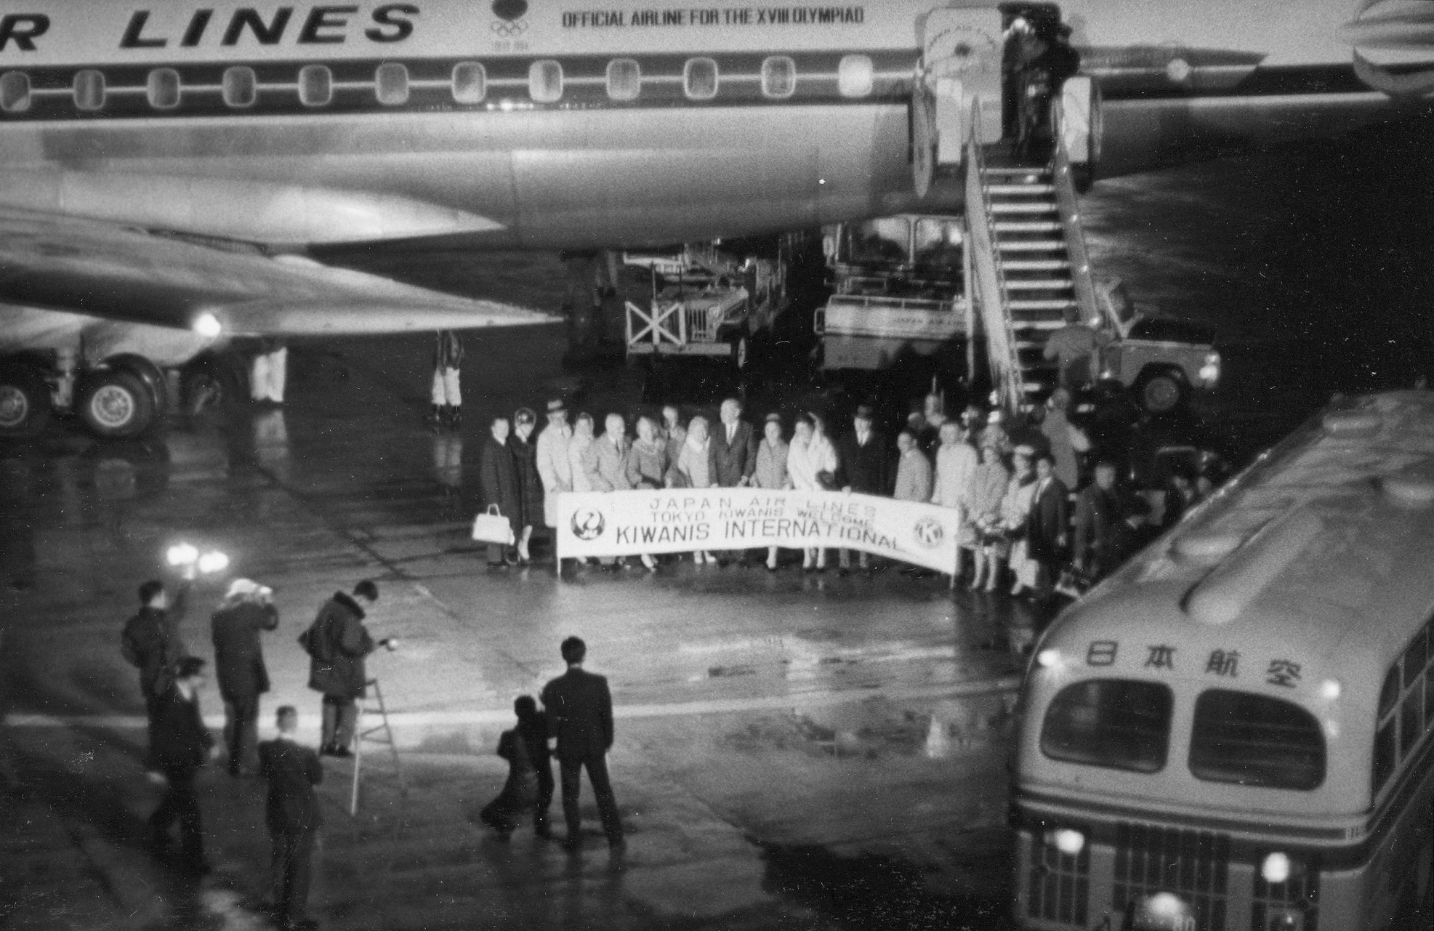
1960s
Photographers capture the 1964 arrival of North American guests for the chartering of Kiwanis' first club in Asia: Tokyo, Japan.

Slide 7
1960s
A two-day horse show--organized by the Sparta, New Jersey, USA, Kiwanis Club--draws more than 200 entries and earned a profit of more than US $900 in the mid 1960s.

Slide 8
1960s
Little Miss Peanut pageants were organized to promote Kiwanis peanut fundraisers. Among the winners is Andrea McArdle, Broadway's original "Annie."

Slide 10
1970s
The Cagayan de Oro Kiwanis Club supports music education for Philippine students.

Slide 11
1970s
Adopting a Kiwanis program titled "Underprivileged Children: A Kiwanis Concern," Costa Rica Kiwanis club members serve a nourishing meal.

Slide 12
1970s
In 1973-74, Cal-Nev-Ha Kiwanis Past Gov. Sid Smith wanted his daughters to be able to have the Key Club experience, but Key Club was restricted to males only. Sid created Keyettes, which became Keywanettes and later KIWIN’S.

Slide 13
1970s
As Key Club became coeducational, so did Keywanettes. Three of the four Districts merged into Key Clubs, leaving Cal-Nev-Ha Keywanettes. In 1995, DCON Delegates voted to change the name to KIWIN’S with all caps and apostrophe and in 2001 became the 32nd District of Key Club International.

Slide 14
1970s
1975: Builders Club became an official Kiwanis-sponsored program for middle school students.

Slide 16
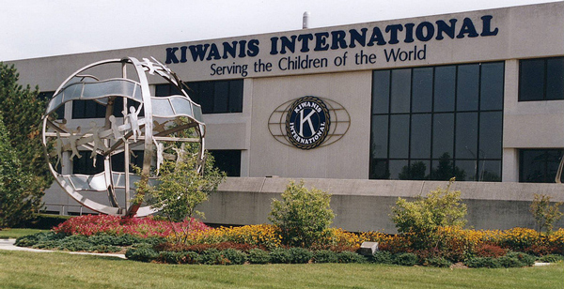
1980s
In August 1982, Kiwanis International moved its headquarters from Chicago to Indianapolis, Indiana.

Slide 17
1980s
July 23, 1984. Kiwanis Family House opened at UC Davis Children’s Hospital. This 32 guestroom house answered an urgent need for temporary housing for families of pediatric patients at UCD and nearby Shriners’ Hospitals.

Slide 18
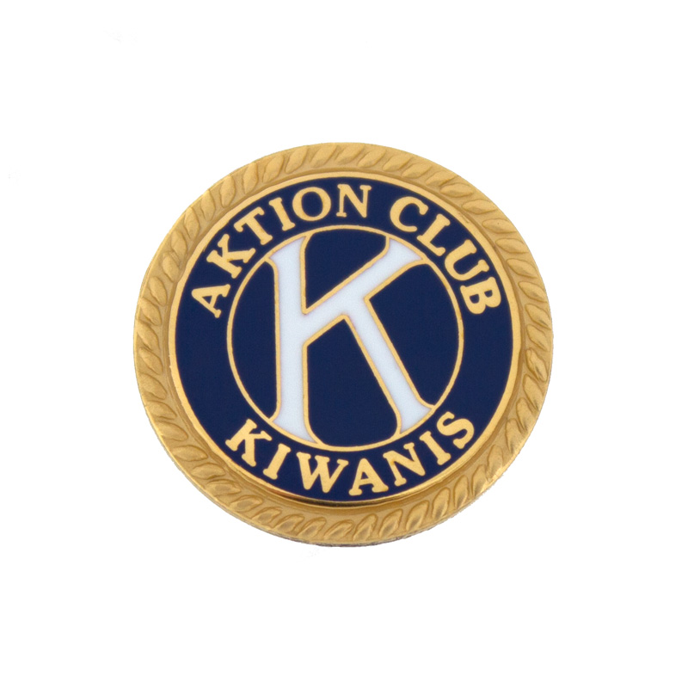
1980s
June, 1987. An Unofficial Aktion Club was formed in Palatka, Florida. It became a sponsored Kiwanis program in 2000.

Slide 19
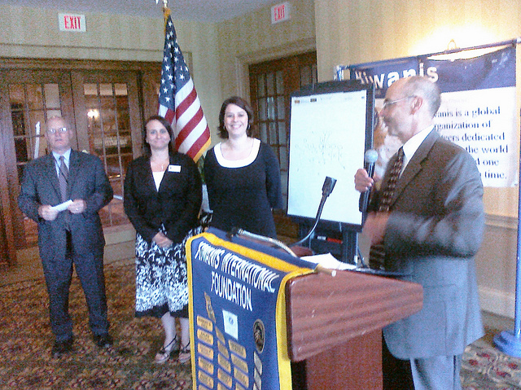
1980s
July 7, 1987 After years of deliberation, delegates approve an amendment to welcome female members into Kiwanis clubs.

Slide 20
1960s through 1980s

