Slide 1
Beginning Through 1920s
Notes:
KIWANIS HISTORY
IN PICTURES

Slide 2
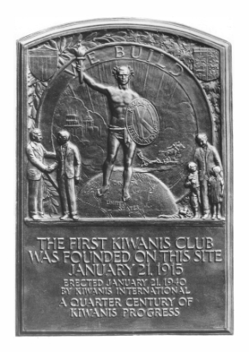
1910s
The Supreme Lodge Benevolent Order Brothers began as a concept in August 1914 by Allen S. Browne , a professional organizer, and Joseph G. Prance, a tailor. “BOB” provided insurance benefits as well as fellowship. Browne kept the $5 membership fee for each new member.

Slide 3
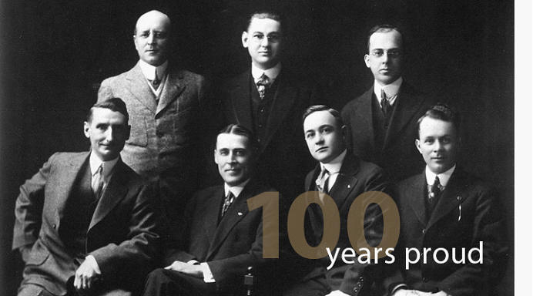
1910s
The first board of the first club includes first Kiwanian Joseph G. Prance (center, back row). The date observed as Kiwanis’ “Birthday” is actually the date that the organization’s corporate charter was returned to the club by the state of Michigan.

Slide 4
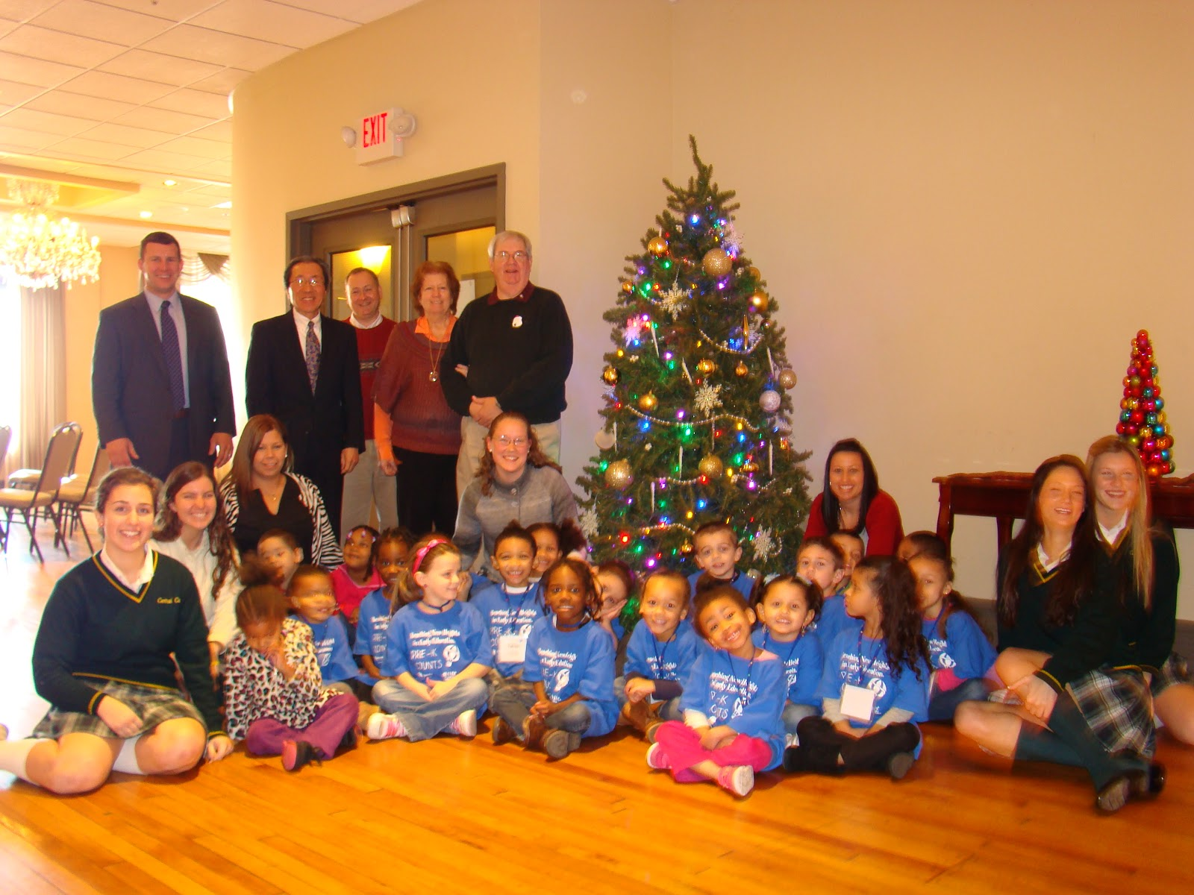
1910s
As the first club grew, members changed the name to NunKee-wan-is, an Indian phrase meaning “We Trade”. By its incorporation the first club had grown to over 200 members. The second club formed in Cleveland, Ohio in 1916. Service to children was emphasized.

Slide 5
1910s
The first convention was held in Cleveland, Ohio May 18 – 19, 1916. A constitution was approved and George Hixson was elected as the president of “The National Kiwanis Club”. Kiwanis became international with the organization of the Kiwanis Club of Hamilton, Ontario on November 1st of that year.

Slide 6
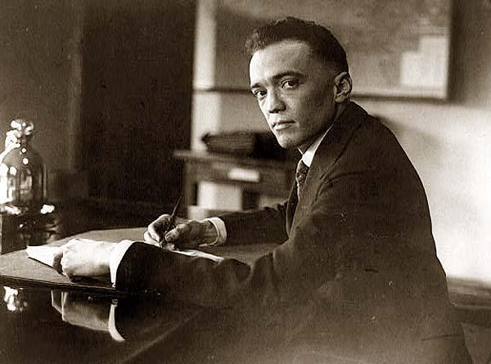
1910s
1919 was an important year in the development of Kiwanis. A paid Secretary oversaw the day to day operation of the clubs. On May 21 convention attendees declared the group’s independence by raising $17,500 in ½ hour to buy Kiwanis from founder Allen Browne.

Slide 7
1910s
Chicago's Webster Building became Kiwanis' second home in 1919, offering more space for a growing organization and its growing staff.

Slide 8
Notes:
KIWANIS HISTORY
IN PICTURES

Slide 9
1920s
Scales, branded with the already renowned “K” were donated in the 1920's by the Kiwanis Club of Hagerstown, Maryland, USA to help measure the 6,000 local schoolchildren's growth.

Slide 10
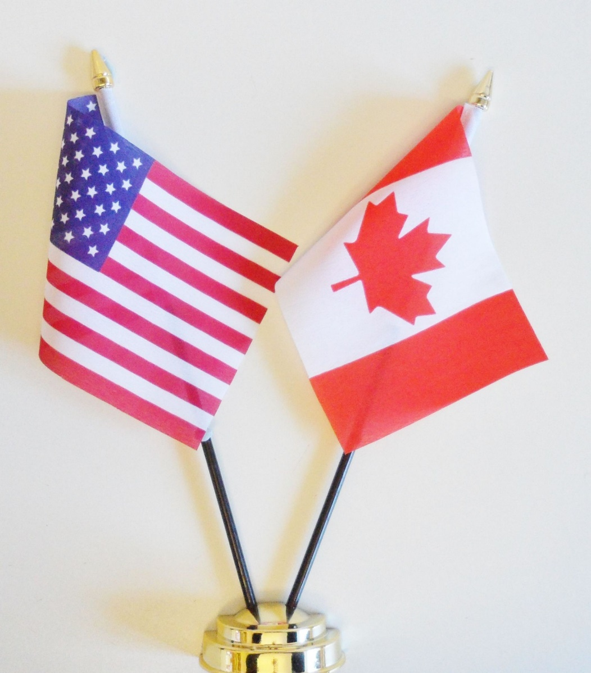
1920s
1920: 28,500 members in 267 clubs. Roe Fulkerson coins the motto “We Build” saying Kiwanis clubs build communities. In 1922 Toronto, Ontario hosted first convention outside of U.S. By 1924, membership reached 90,000 in more than 1,200 clubs.

Slide 11
1920s
Kiwanis clubs have a long history of providing transportation for police, fire and emergency departments.

Slide 12
1920s
The Objects of Kiwanis. The six permanent Objects of Kiwanis International were approved by Kiwanis club delegates at the 1924 Convention in Denver, Colorado. Through the succeeding decades, they have remained unchanged.

Slide 13
Object 1 - To give primacy to the human and spiritual rather than to the material values of life.

Slide 14
Object 2 - To encourage the daily living of the Golden Rule in all human relationships.

Slide 15
Object 3 – To promote the adoption and the application of higher social, business, and professional standards.

Slide 16
Object 4 – To develop, by precept and example, a more intelligent, aggressive and serviceable citizenship.

Slide 17
Object 5 – To provide, through Kiwanis clubs, a practical means to form enduring friendships, to render altruistic service, and to build better communities.

Slide 18
Object 6 – To cooperate in creating and maintaining that sound public opinion and high idealism which make possible the increase of righteousness, justice, patriotism, and goodwill.

Slide 19
1920s
1925 – Kiwanis sponsors the first Key Club, at Sacramento High School. It was described in Kiwanis magazine as “a junior service club composed of high school boys who are the key boys of the school”. Key Clubs were supervised by Kiwanis clubs, but involved school administrators.

Slide 20
1920s
Five Akron, Ohio, USA, members have their arms full of babies from a "refuge for unwed mothers," which the club supported in 1926.

Slide 21
1930s through 1950s

